Slide 1

WEB APPLICATION FOR PATHUM DANANSOORIYA CULTURAL ENSAMBLE

Slide 2
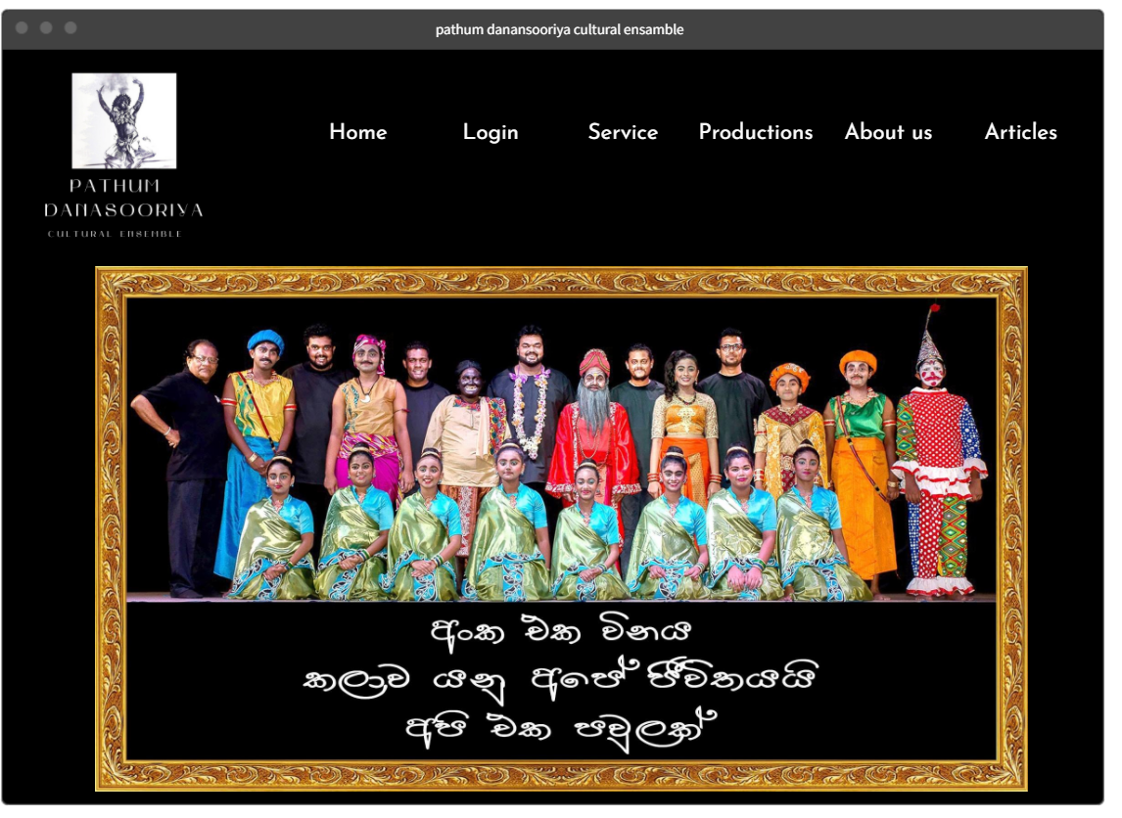
HOME PAGE

Slide 3
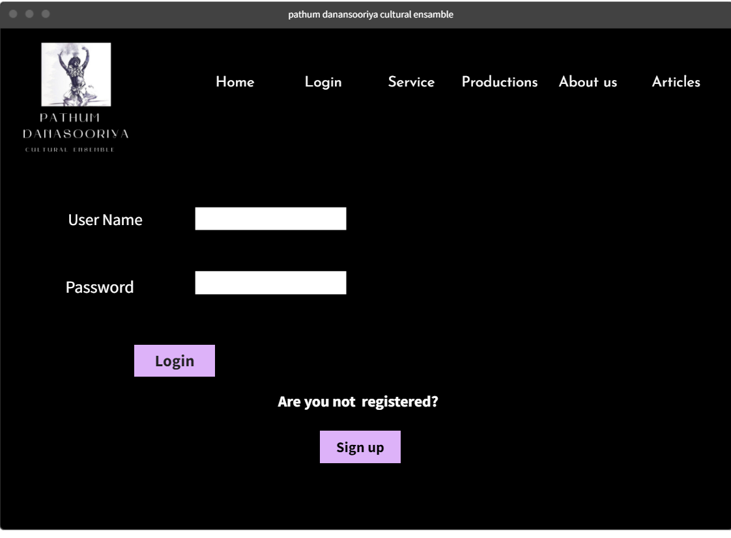
LOGIN PAGE

Slide 4
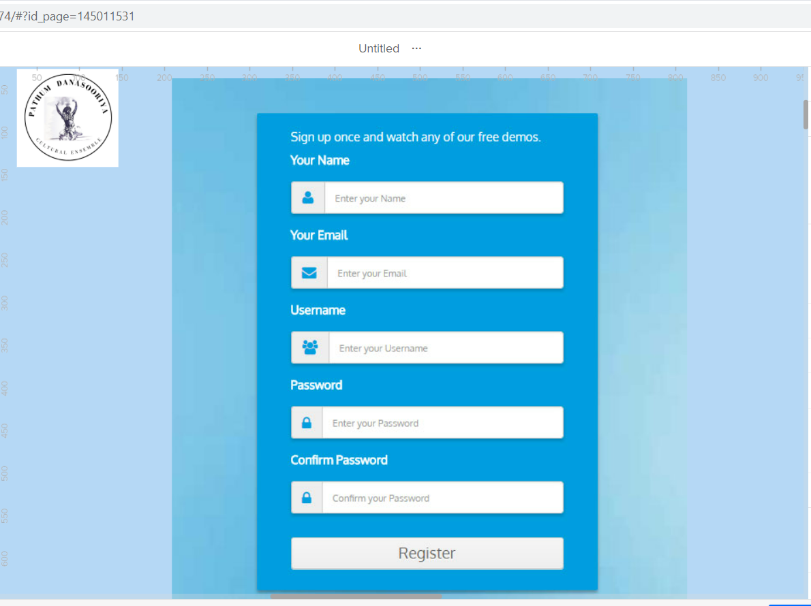
SIGNUP PAGE

Slide 5
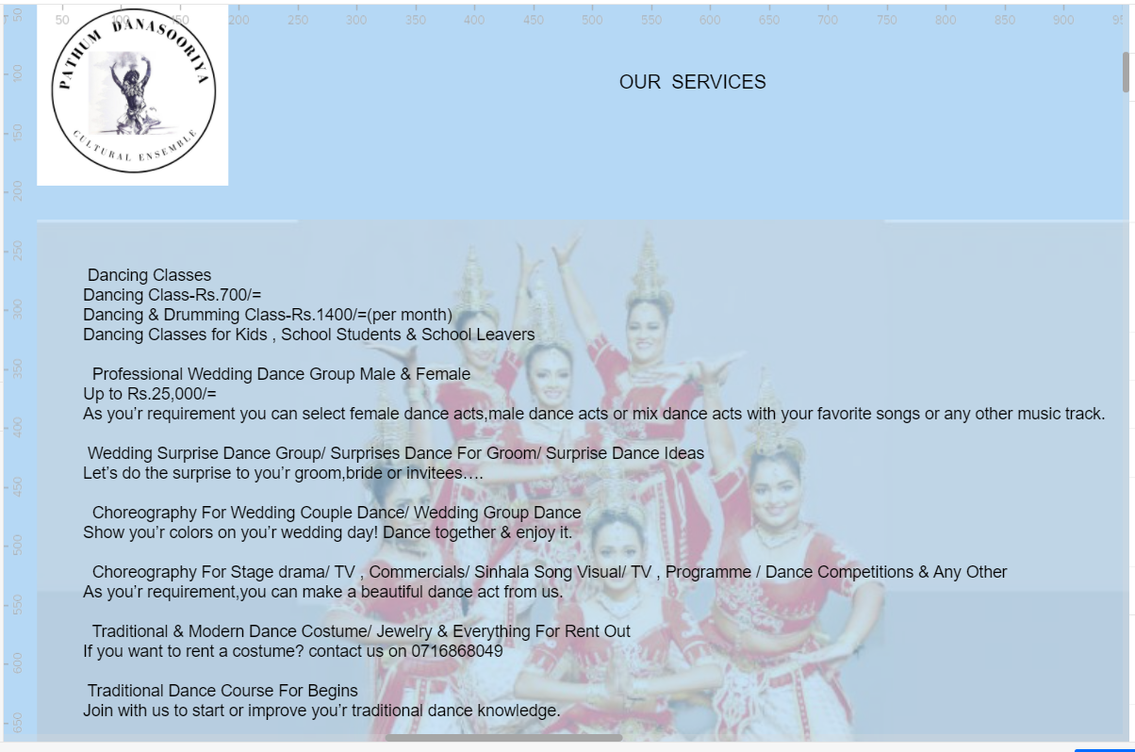
SERVICES PAGE

Slide 6
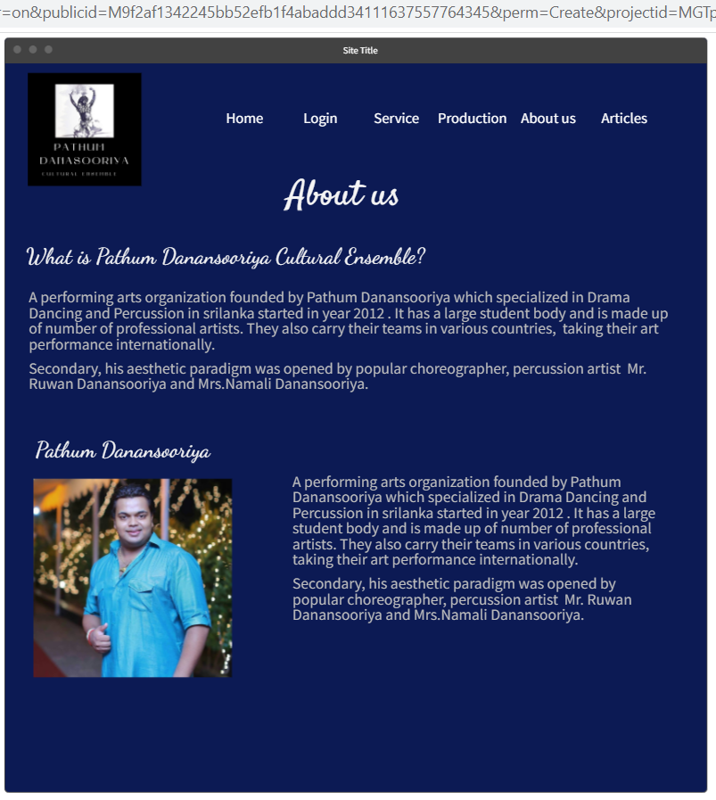
About us

Slide 7
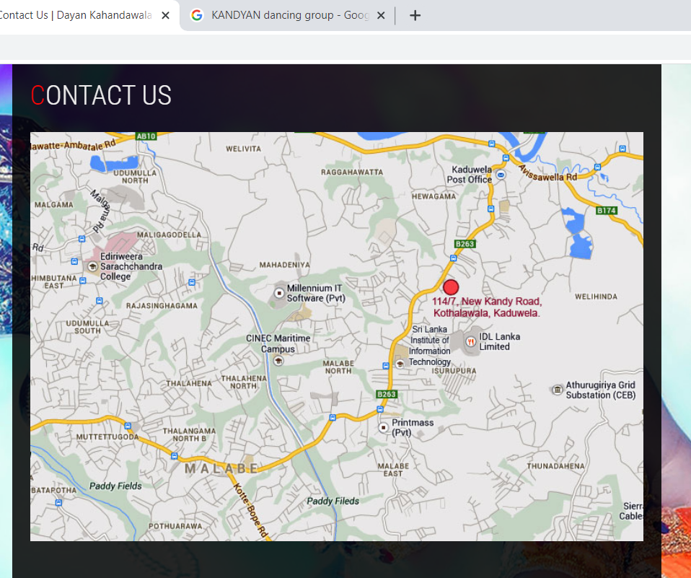
CONTACT US

Slide 8
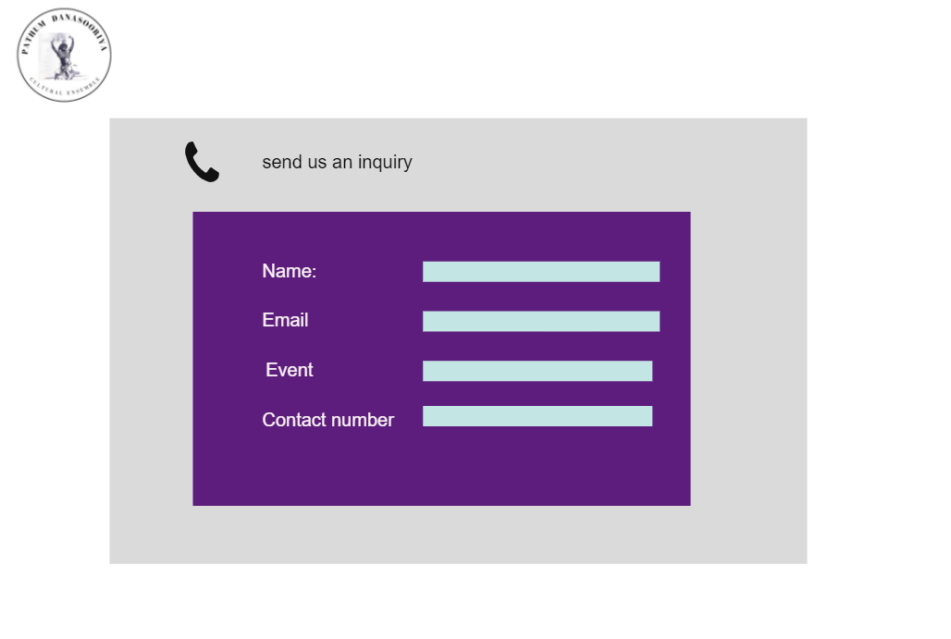
Inquiry form

Slide 9
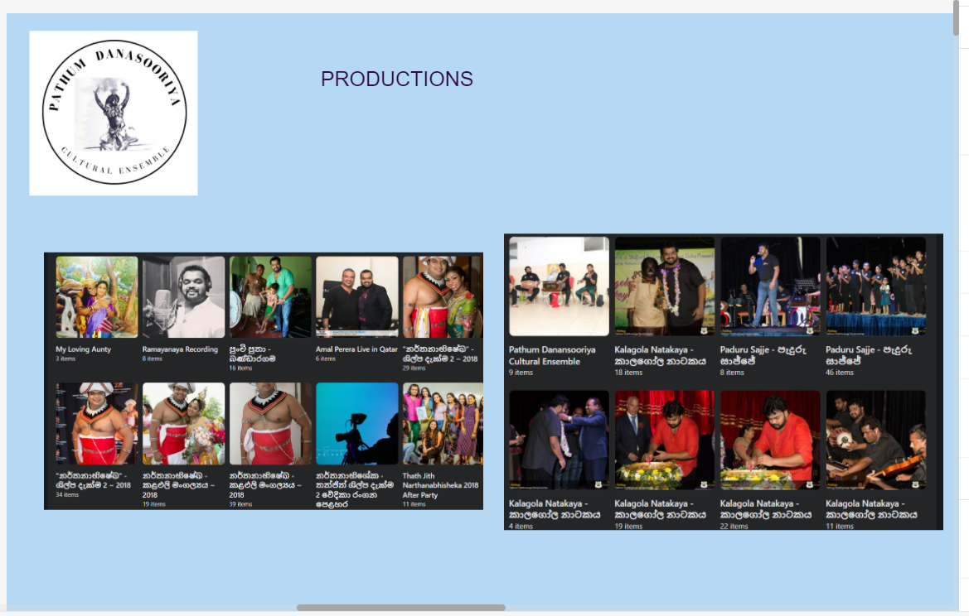
PRODUCTION PAGE

Slide 10
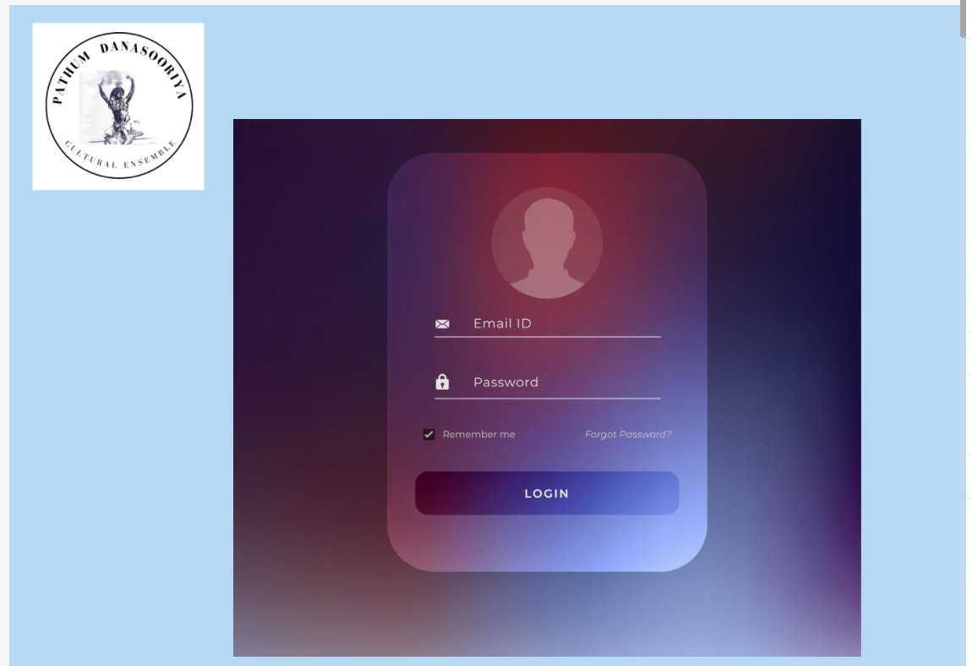
ADMIN LOGIN

Slide 11


